Slide 1
Logistics optimization for delivery routes – dhl SQL Project Nandini More (15 Oct ds batch)

Slide 2
Project objective
Build a logistics analytics system to analyze shipment performance, optimize routes and enhance delivery efficiency across DHL’s global network.

Slide 3
Questions to answer
Identify Delay patterns and operational inefficiencies.
Optimize hub and route combinations for improved transit times.
Analyze agent and warehouse-level performance.

Slide 4
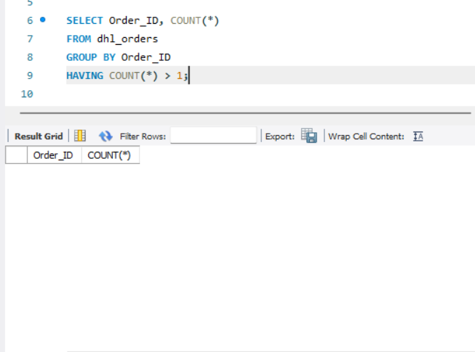
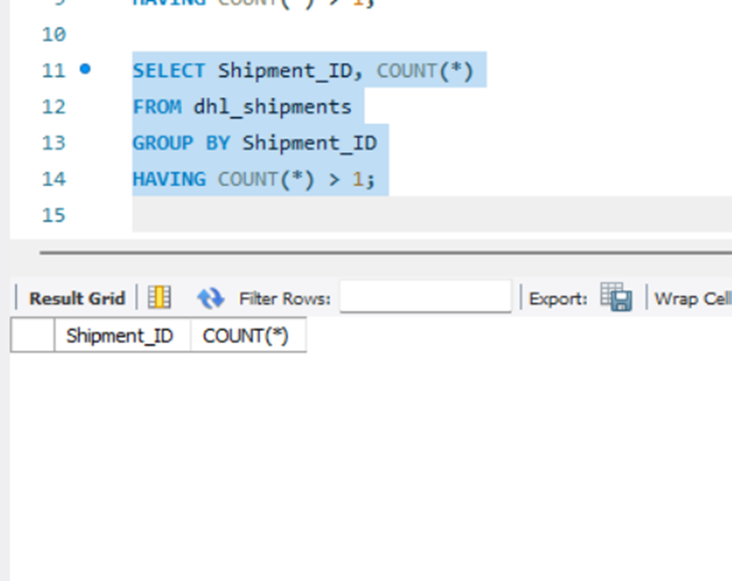
Task 1 – DATA CLEANING & PREPARATION
1.1 Identify and delete duplicate Order_ID and Shipment_ID:
No duplicate IDs were found

Slide 5
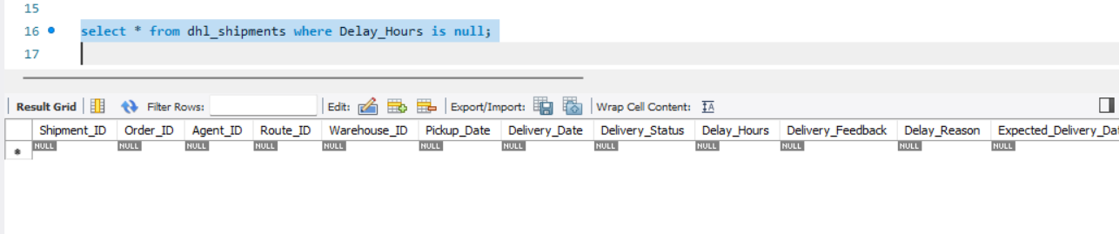
1.2 Replace null Delay_Hours in the Shipments table
No null values were found

Slide 6
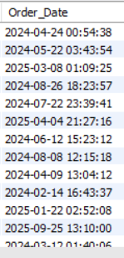
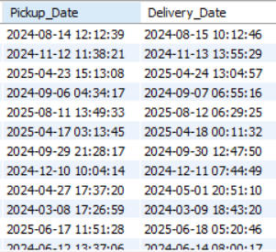
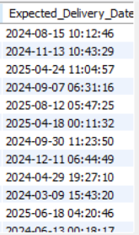
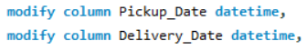
1.3 Convert date columns into DateTime format:
Modified all dates using datetime function to get the desired output i.e. YYYY-MM-DD HH:MM:SS

Slide 7
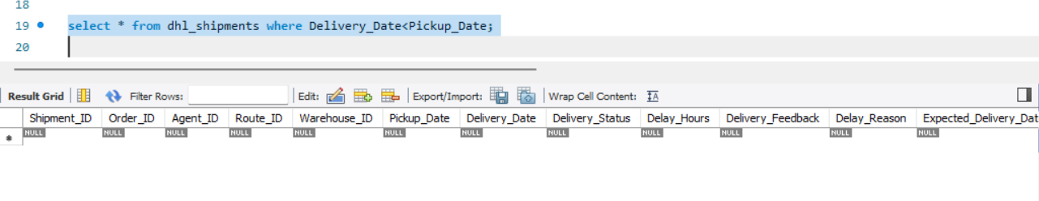
1.4 Ensure delivery_date > pickup_date :
Used comparison operator on delivery_date and pickup_date to ensure correctness

Slide 8
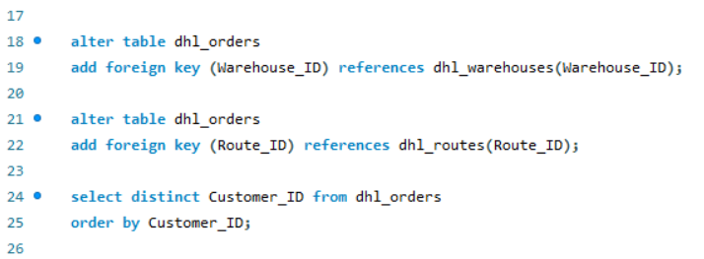
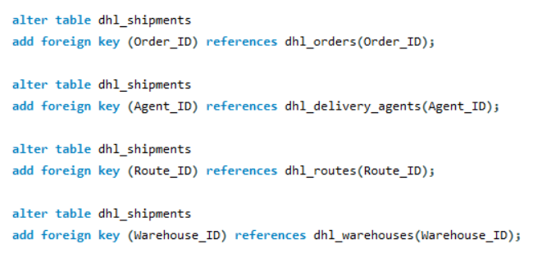
1.5 Validate referential Integrity:
Validated referential integrity between tables by creating relationships between them using foreign keys

Slide 9
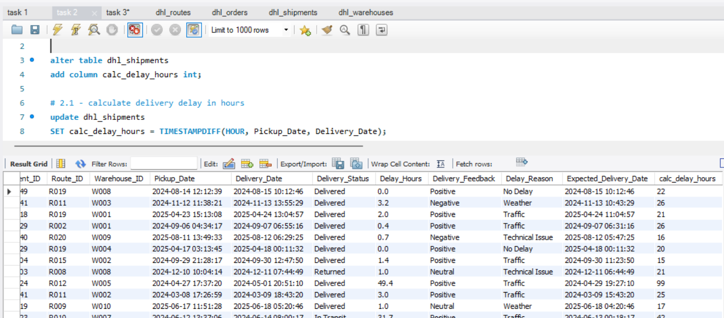
Task 2 – Delivery delay analysis
2.1 Calculate Delivery Delay in Hours for each Shipment:
Created a new column calc_delay_hours to calculate delivery delay in hours for each shipment, so that the data consistency for the entire table stays intact and to also find top 10 routes as stated in task 2.2

Slide 10
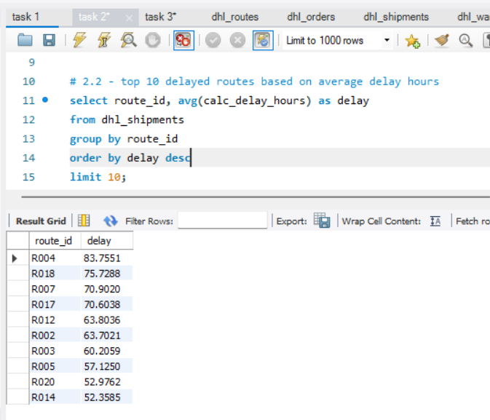
2.2 Top 10 delayed routes based on average delay hours:
Used order by on aggregated column avg(calc_delay_hours) and ordered them by desc.

Slide 11
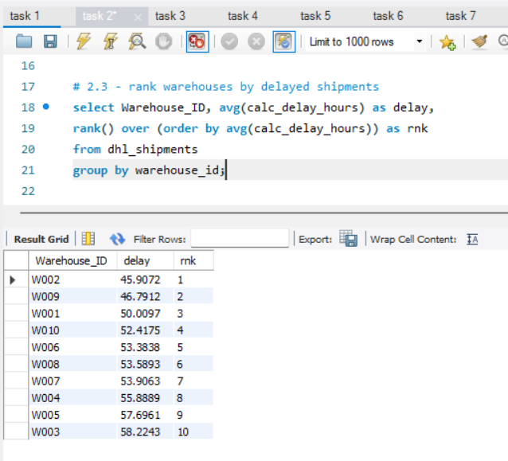
2.3 Window function to rank shipments by delay for each warehouse :
Used window function rank to rank all the warehouses based on average delay hours.

Slide 12
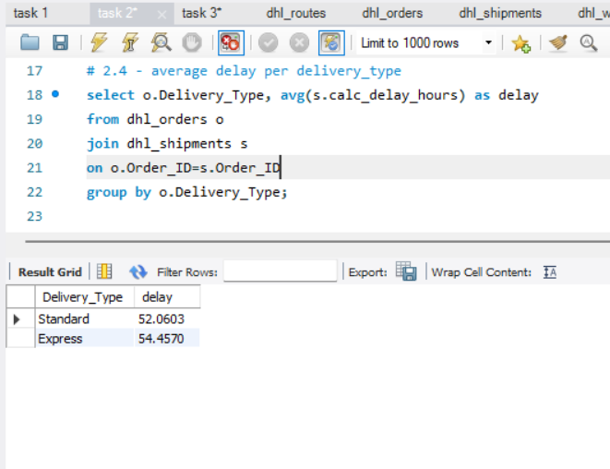
2.4 Average delay per delivery type :
Performed inner join on Orders and Shipments to join the common tables and then performed group by on delivery_type

Slide 13
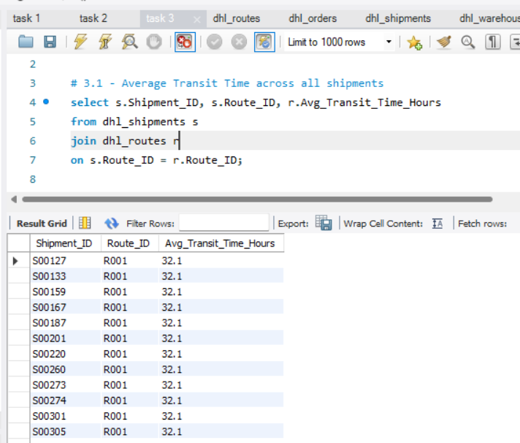
Task 3 – Route optimization insights
3.1 Average Transit time across all shipments:
Inner join on shipments and routes and selected average_transit_time_hours.

Slide 14
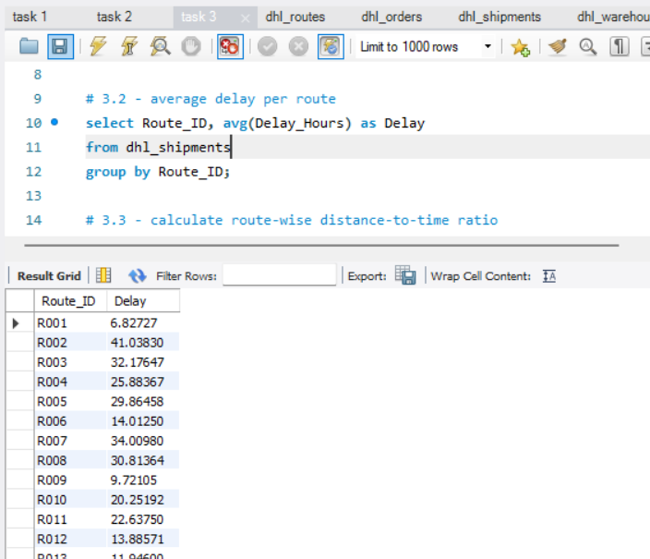
3.2 Average delay per route:
Aggregated average delay as delay and grouped by route ids so we could get average delay per route.

Slide 15
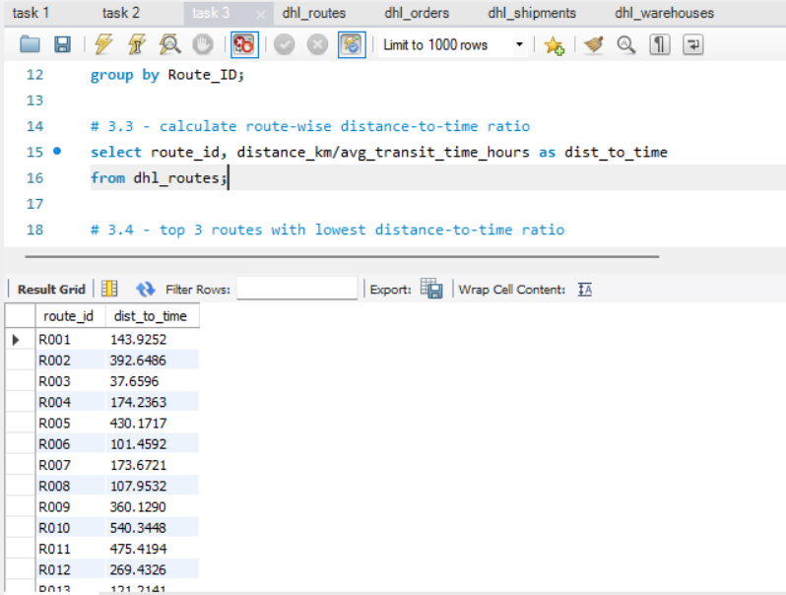
3.3 Distance-to-time efficiency ratio:
Calculated distance-to-time ratio using select statement so that the size of the table does not unnecessarily increase.

Slide 16
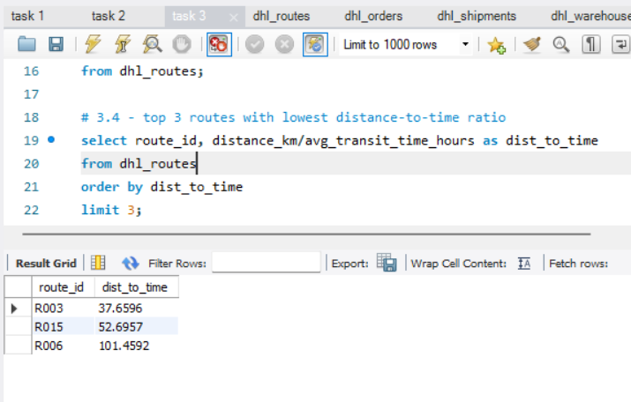
3.4 Top 3 worst efficiency routes:
Order by asc based on the distance-to-time ratio and then set the limit to 3 to find top 3 worst efficiency routes

Slide 17
3.6 Recommend potential routes for optimization:
Routes with route_id R003, R015 and R006 have the worst distance-to-time efficiency, thus should be optimized better by changing the route so that the distance decreases and avg transit time also decreases thus having better efficiency.

Slide 18
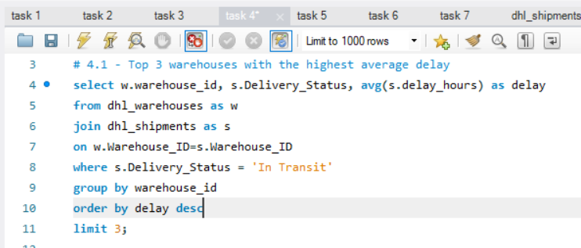
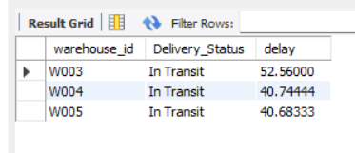
Task 4 – warehouse performance
4.1 Top 3 warehouses with the highest average delay in shipments dispatched.
Joined tables dhl_warehouses and dhl_shipments, filtered using where clause where the shipments were in transit, applied group by, order by and limit operations on query.

Slide 19
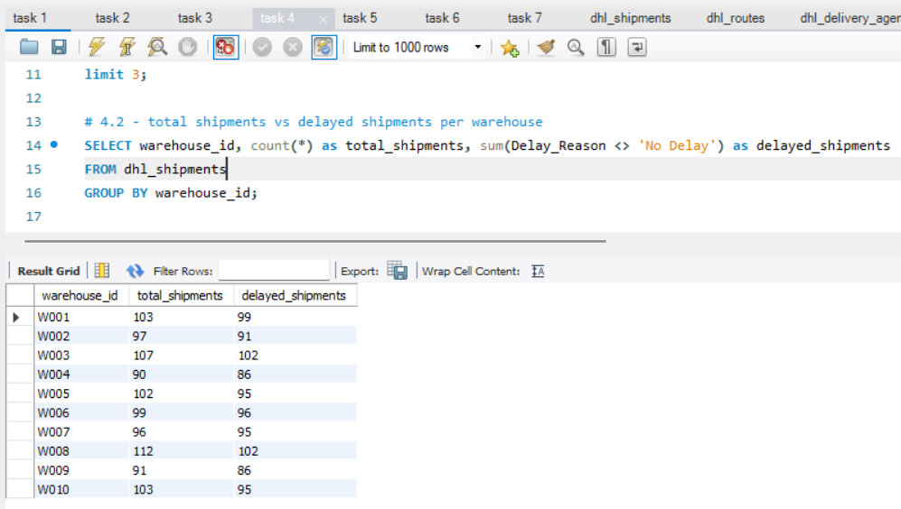
4.2 Total shipments vs delayed shipments for each warehouse
Used aggregated functions and Group by clause

Slide 20
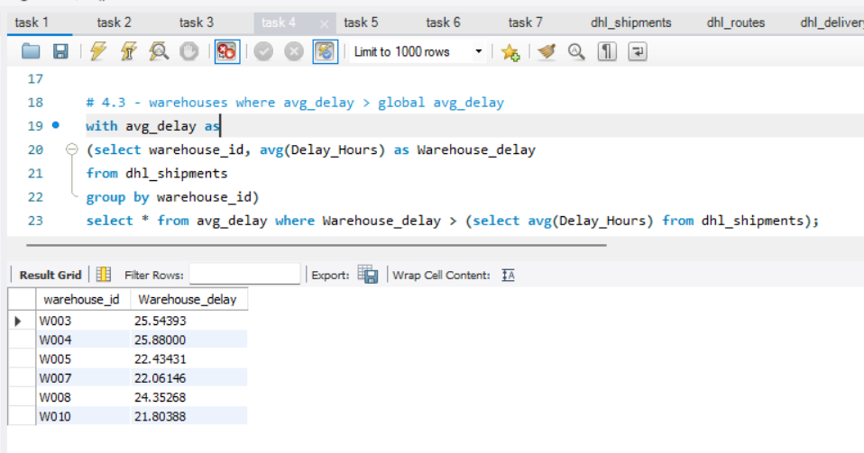
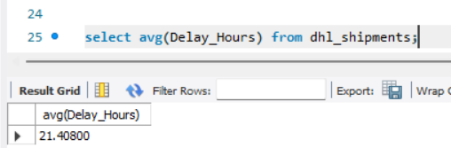
4.3 CTE to identify warehouses where avg delay > global delay
Defined global delay as an average of delay across all warehouses, used CTE, group by clause and aggregated functions

Slide 21
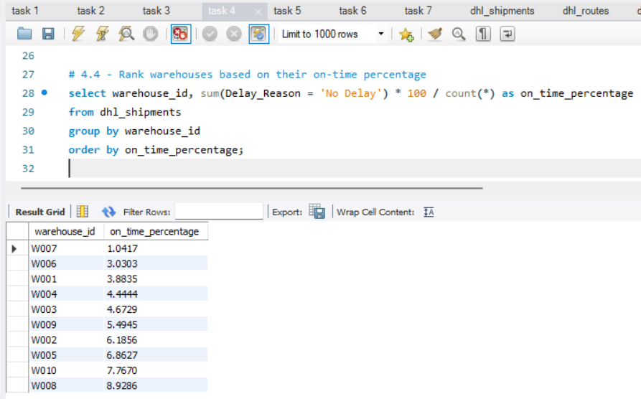
4.4 Rank all warehouses based on on-time delivery percentage
Used aggregated functions, group by and order by to display warehouses in ascending order of their on-time delivery percentage

Slide 22
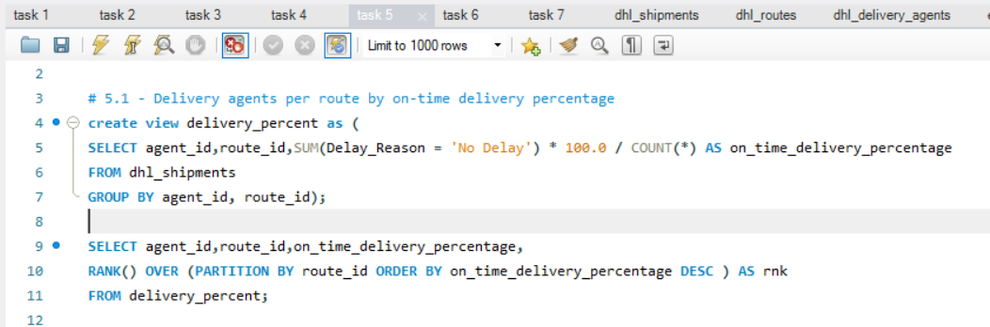
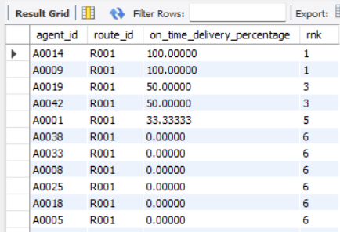
Task 5 – delivery agent performance
5.1 Rank delivery agents per route by on-time delivery percentage
Created a view to calculate on delivery percentage, used a window function rank() on the view to analyze delivery agent’s performance.

Slide 23
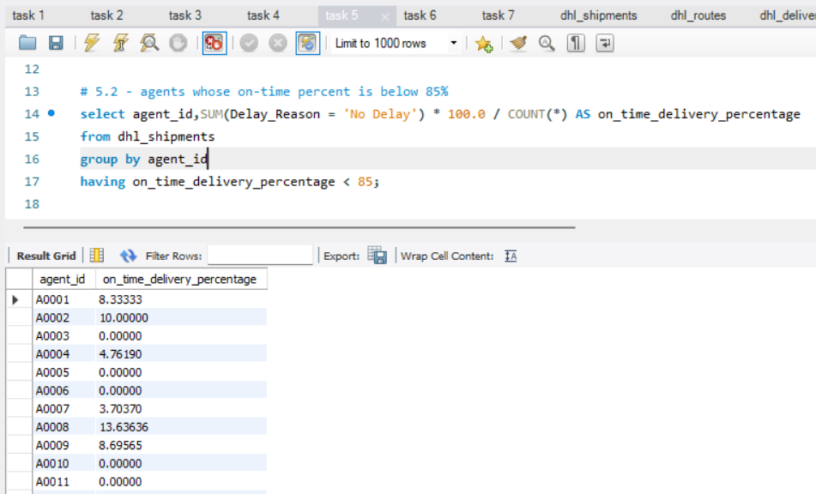
5.2 Find agents whose on-time percent is below 85%
Aggregated values across all shipments and agents, used group by along with the having clause to find agents with on-time percent < 85

Slide 24
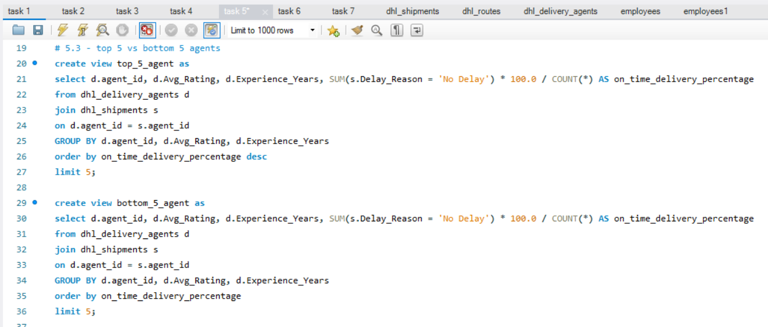
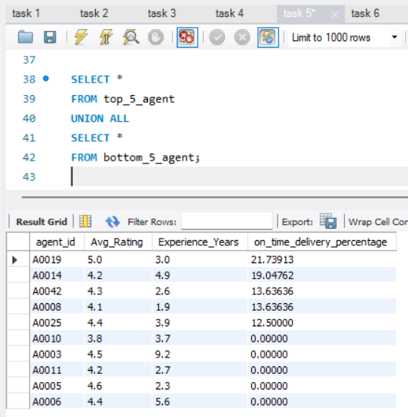
5.3 Compare average rating and experience of top 5 vs bottom 5 agents
Created 2 separate views to calculate top 5 and bottom 5 agents, then used union all on both the views to get result

Slide 25
5.4 Suggest training or workload balancing strategies for low performing agents
As we can see in the table, the avg rating across low performing and high performing agents is almost equal, but there is a difference in experience years, the low performing agents have slightly more experience than high performing ones.
Thus a Refresher Training session should be organized for agents with a certain experience level so that they can be upskilled again and can work alongside the younger workforce.

Slide 26
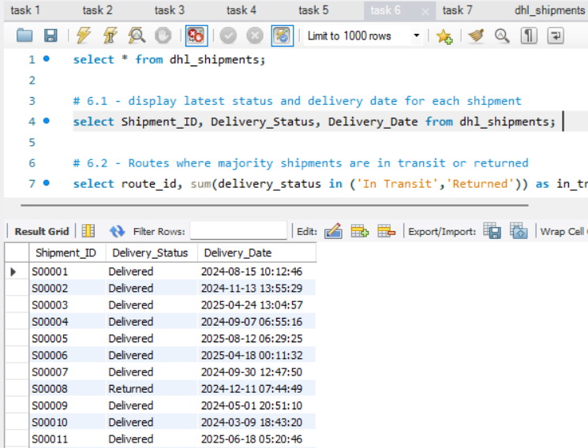
Task 6 – shipment tracking analysis
6.1 Display latest status along with latest delivery date for each shipment.
Used Select statement on dhl_shipments table to retrieve and display the said information.

Slide 27
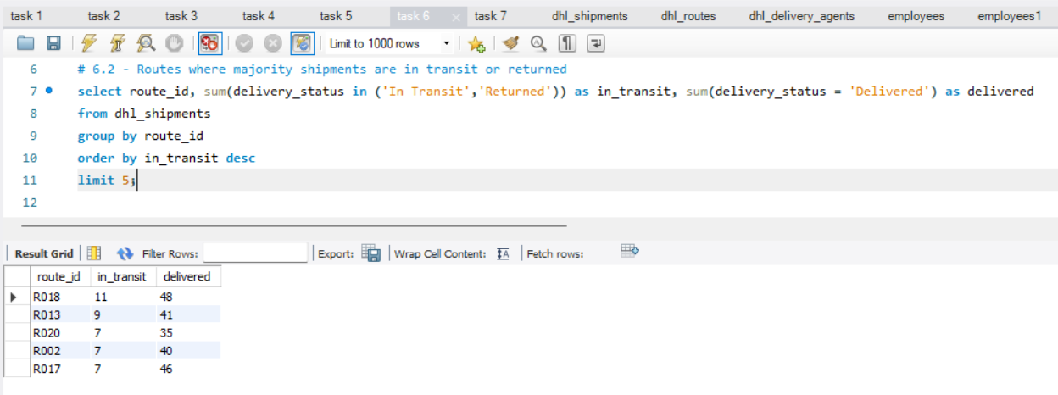
6.2 Identify routes where majority shipments are ‘In Transit’ or ‘Returned’
Used aggregate functions along with IN operator and identified top 5 routes where majority shipments are still ‘In Transit’ or ‘Returned’

Slide 28
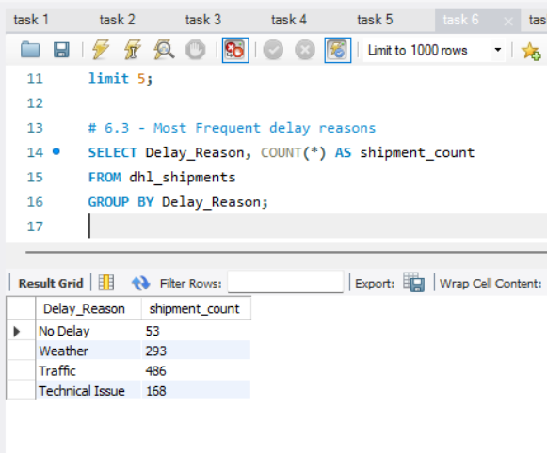
6.3 Find the most frequent delay reasons
Used count and group by to identify the most frequent delay reasons

Slide 29
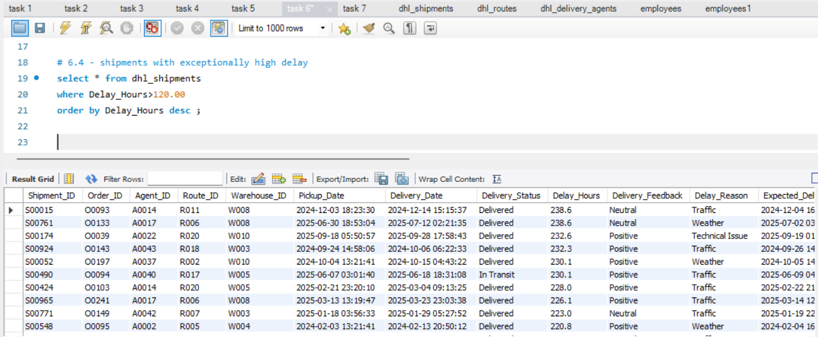
6.4 Identify order with exceptionally high delays
Identified orders with delay hours over 120 and ordered them in descending order to identify potential causes such as specific routes, warehouses or a certain delay reason such as traffic or weather.

Slide 30
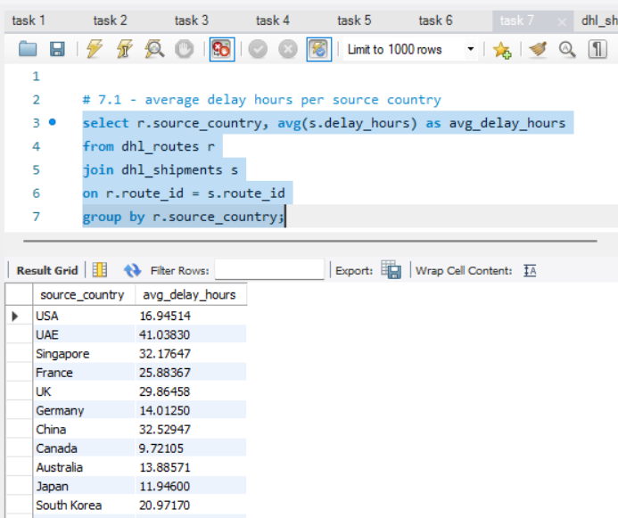
Task 7 – advanced kpi reporting
7.1 Average delivery delay per source country
Performed inner join on tables routes and shipments and the aggregated delay hours, grouped by every source country

Slide 31
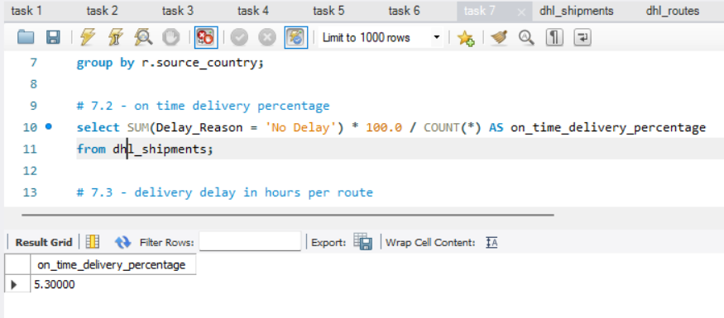
7.2 On time delivery percentage
Calculated on time delivery percentage by using select statement to calculate an aggregated value across the entire shipments table

Slide 32
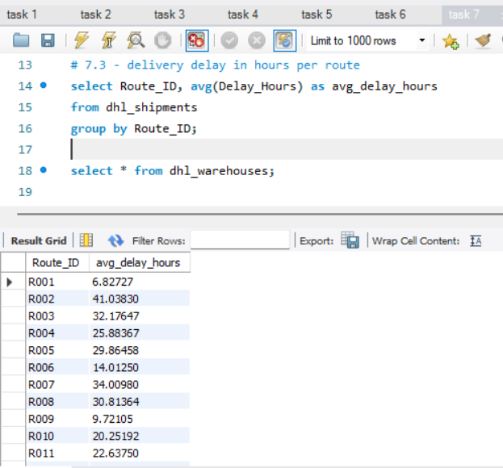
7.3 Average Delay per route
Used aggregated values, aliases and group by function to calculate average delay per route using shipments table

Slide 33
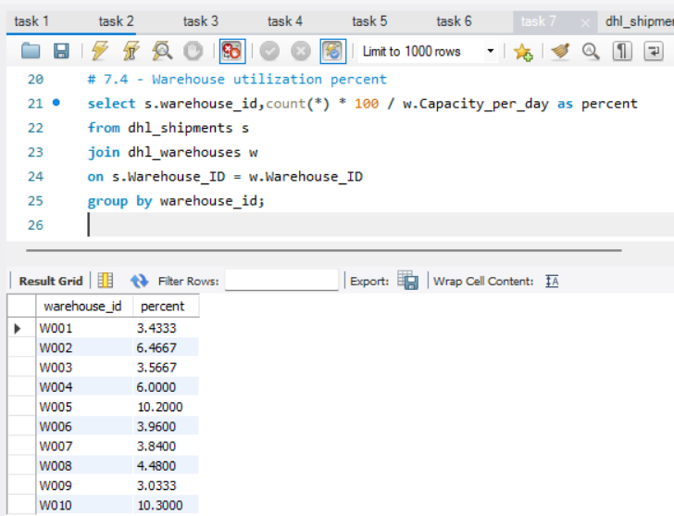
7.4 Warehouse utilization percentage
Calculated percent using aggregated functions, used join on warehouses and shipments, used group by.

Slide 34
TASK 9 – VIDEO SUBMISSION
One Drive link -https://drive.google.com/file/d/1zt1TRg7nyLJOsj7Q8vKGrI4Fbcyel3Cj/view?usp=sharing

Slide 35

Thank you
Nandini More
15 October
Data Science Batch

